Slide 1
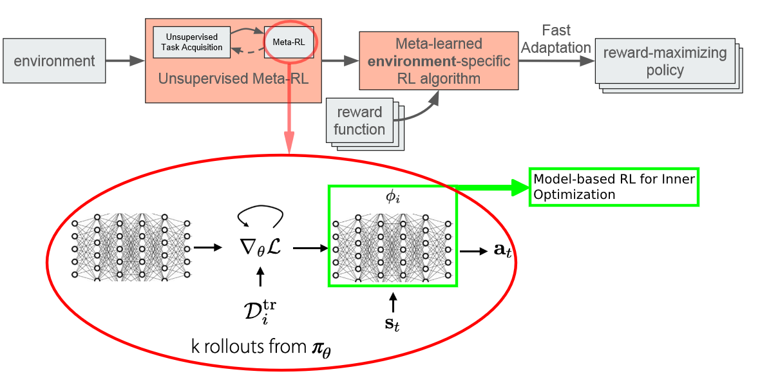
Main Objective #1
2. Unsupervised / Automatic Task Acquisition in Meta-RL Gupta, A., Eysenbach, B., Finn, C., & Levine, S. (2018). Unsupervised Meta-Learning for Reinforcement Learning. ArXiv, abs/1806.04640.
1. Model-based Meta-RL Nagabandi, A., Clavera, I., Liu, S., Fearing, R., Abbeel, P., Levine, S., & Finn, C. (2019). Learning to Adapt in Dynamic, Real-World Environments through Meta-Reinforcement Learning. arXiv: Learning.

Slide 2
Roadmap & Progress
PETS
MAML
Milestone 1: Model-Based RL + Meta-RL
Nagabandi, A., Clavera, I., Liu, S., Fearing, R., Abbeel, P., Levine, S., & Finn, C. (2019). Learning to Adapt in Dynamic, Real-World Environments through Meta-Reinforcement Learning. arXiv: Learning.
Unsupervised RL
Milestone 2: Unsupervised RL + Meta-RL
Gupta, A., Eysenbach, B., Finn, C., & Levine, S. (2018). Unsupervised Meta-Learning for Reinforcement Learning. ArXiv, abs/1806.04640
Milestone 3: Milestone 1 + Milestone 2
Model-Based RL
(benefit: adapt to different reward functions efficiently / quickly)
Meta-RL (benefit: adapt to changes in the env)
Unsupervised RL (benefit: automate [meta] task acquisition/design)

Slide 3
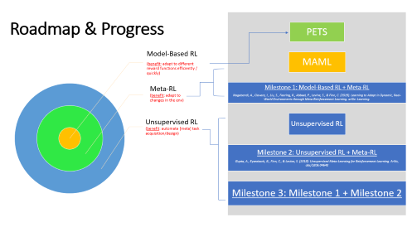
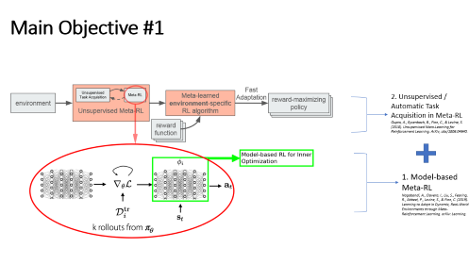
Overview

